Slide 1
Intensio
Simon Says Memory Game

Slide 2
Team Members
Timothy Sullivan
William Holder
Hao Wu
Jason Purcell
Ric Poirson

Slide 3

Project Management
William Holder
Project Lead/ Meeting Organizer/Programming Lead/Documentation Lead

Slide 4


Project Management
Met twice a week on skype
Used big blue button to screen share

Slide 5

Project Management
Quality Assurance
Github
Timothy Sullivan

Slide 6
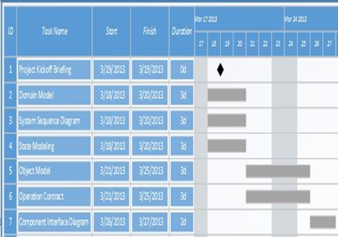
Project Management
Gantt Chart

Slide 7
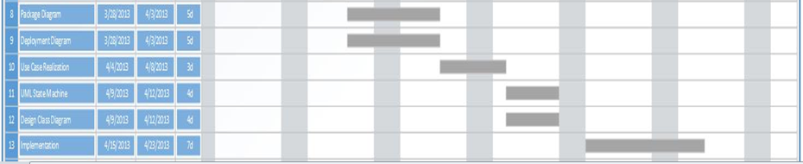
Project Management
Gantt Chart 2
Package Diagram
Deployment Diagram
Use Case Creation
UML State Machine
Design Class Diagram
Implementation

Slide 8
Project Management
Lessons Learned
Start coding sooner
Don’t use waterfall
In person meetings
Technical environment set up sooner
Model and Controller are easier to program than the view
Do not constantly move deadlines
Manager Specific
Start meetings with a plan

Slide 9
Requirements Analysis
Use Case Text
Use Case: Play Simon Says
Player logs into his account
Player selects preferred options for the game
System timer starts
Player is presented with a number of objects based on selected options.
A sequence of objects are activated in sequence by the system.
Objects are activated by the user to mimic the displayed sequence.
If sequence is successfully duplicated, the player moves to the next round, earns points, and steps 5-6 are repeated
Else the game ends

Slide 10
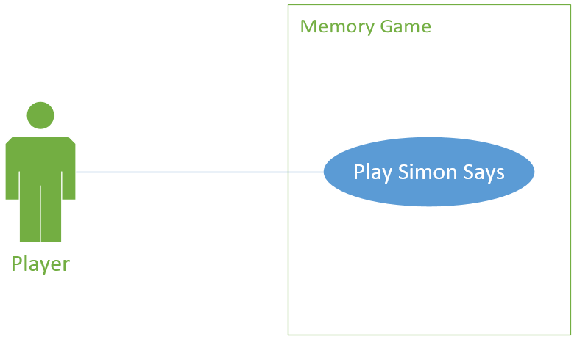
Requirements Analysis
Use Case Diagram

Slide 11
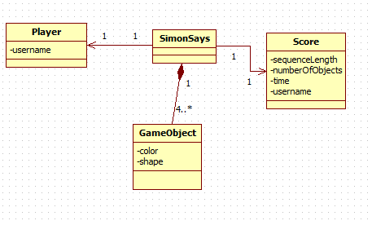
Requirements Analysis
Domain Model

Slide 12
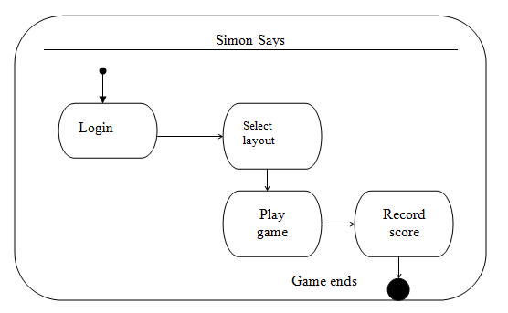
Requirements Analysis
State Machine Diagram

Slide 13
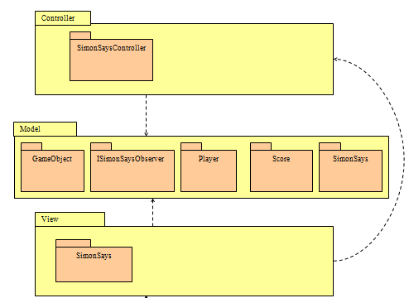
Design
Package Diagram

Slide 14
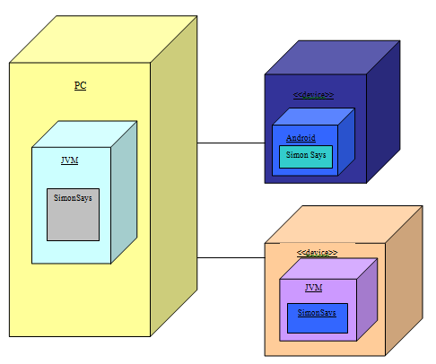
Design
Deployment Diagram

Slide 15
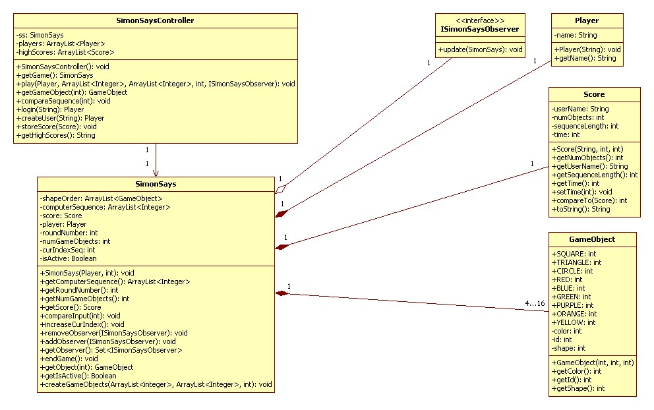
Design
Design Model

Slide 16
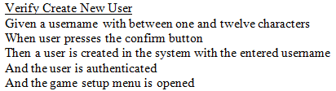
Testing
Functional Testing
Manual tests against requirements
Extensive use of the debugger
Code Reviews

Slide 17
Testing
User Interface Testing
Comparison with requirements
Free form testing

Slide 18
Testing
Performance Testing
Regular execution of program
Evaluation of performance by multiple group members

Slide 19
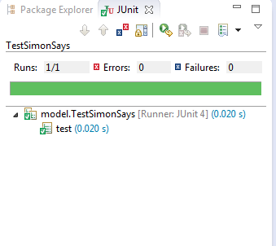
Testing
Unit Testing
Unit testing was performed on the model
Difficulties translating to Android tests

Slide 20
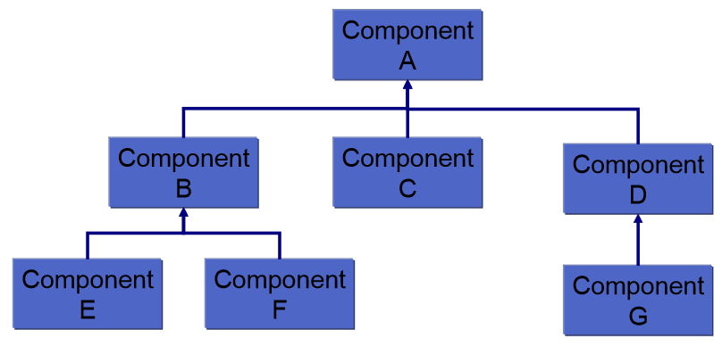
Testing
Integration Testing
Planned on using the Bottom-Up model
Did not get to due to difficulties with unit testing in Android and implementation

Slide 21
Implementation
Android Programming
William Holder
Timothy Sullivan
Java Applet
Jason Purcell
Ric Poirson

Slide 22
Implementation
Complications:
Sakai was slow to rearrange and get documentation
We switched to Github
Big Blue Button was inefficient
Switched to Skype
Used BBB for screen share
Group had different schedules and inconsistent work loads
Meeting were changed to twice a week
More flexible task assignment

